Slide 1

USA PERFORMANCE℠
Manage Performance, Ensure Success
OPM’s Performance Management System for Federal Agencies
USA Performance Training for Administrators – Day 1
[insert Agency Name]
[insert date]
OFFICIAL USE NOTICE: This material is intended exclusively for use by USA Performance Customers and is not to be distributed without approval from the USA Performance Program Office. This communication may contain information that is proprietary, privileged, confidential or otherwise legally exempt from disclosure. If you have received this presentation in error, please notify the USA Performance Program Office immediately and delete all copies of the material.
Notes:
Discuss why we’re onsite and what we do at HRS.

Slide 2
Today’s Agenda
Overview and Background
System Access
System Orientation
Navigate the Performance Management Tab
Navigate the Admin Tab
Navigate the Reports Tab
Navigate the Resources Tab
Manage and Act as a Proxy
Check on Learning
Notes:
Now is a good time to discuss expectations for the training. It’s beneficial to write down specific expectations from participants and check them off as they are met.

Slide 3
What is USA Performance?
USA Performance is the U.S. Office of Personnel Management’s Performance Management System for Federal Agencies
USA Performance is OPM’s software-as-a-service solution for managing individual employee performance
First released in July 2014 for the SES performance appraisal process
It is the only automated system on the market designed by federal HR experts to meet federal agencies’ needs and government-wide regulations and best practices
It enables agencies to automate their performance appraisal process throughout the entire performance rating cycle
Agencies can directly tailor the system to meet their own performance management requirements; no customization is required by OPM
USA Performance is hosted and maintained by OPM; the system meets all relevant Federal IT security and compliance requirements

Slide 4




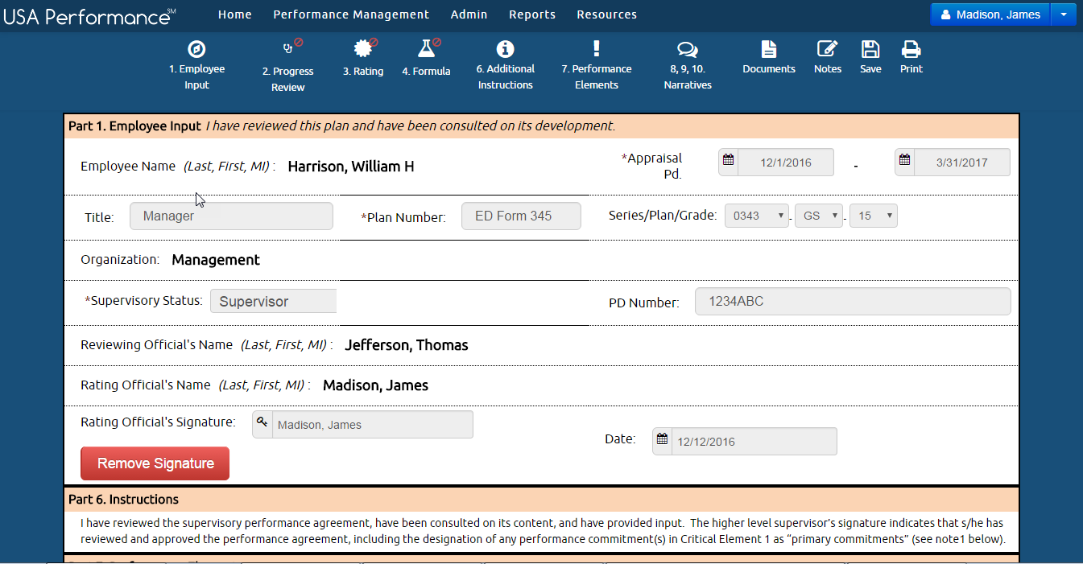

Employee
View plans and add accomplishments year round
Streamlined, intuitive process
Easy transition from paper performance plans to a standard online performance plan
Transparent process builds trust and credibility of agency performance appraisals
Ensures scalability, reliability, performance, and availability in light of increased demands for functionality, volume, and security
USA Performance Employee Interface
Users are never more than one click from their performance plan. The dashboard makes relevant tasks top-of-mind.
Notes:
Discuss the differences between employees, rating officials, reviewing officials and admins here and on the next slide.

Slide 5
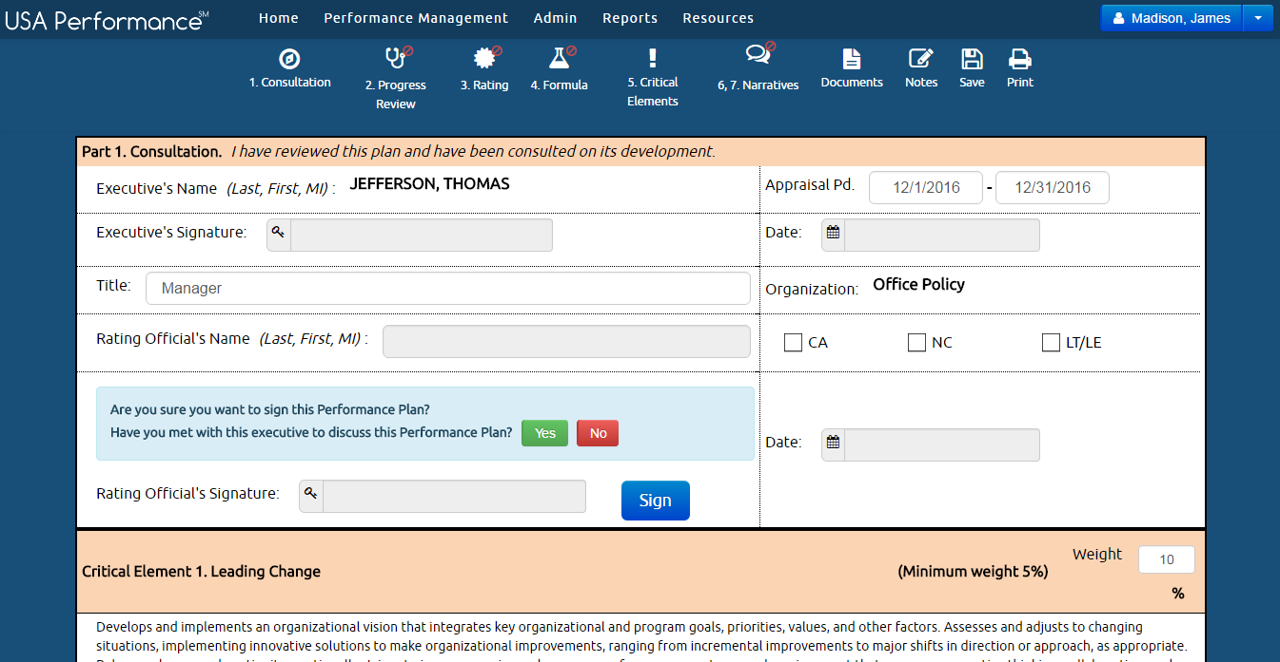
Rating Officials
Create and review plans, add accomplishments and provide feedback in one place
Maintain feedback and performance information in one place
Spend more time on feedback, less time on paperwork
Align and then evaluate individual performance against overall program performance
USA Performance Rating official Interface: “Signing Plan”
Standard best practices are built in to help the Rating Official navigate the process while ensuring accountability to the employee and agency-specific requirements.

Slide 6
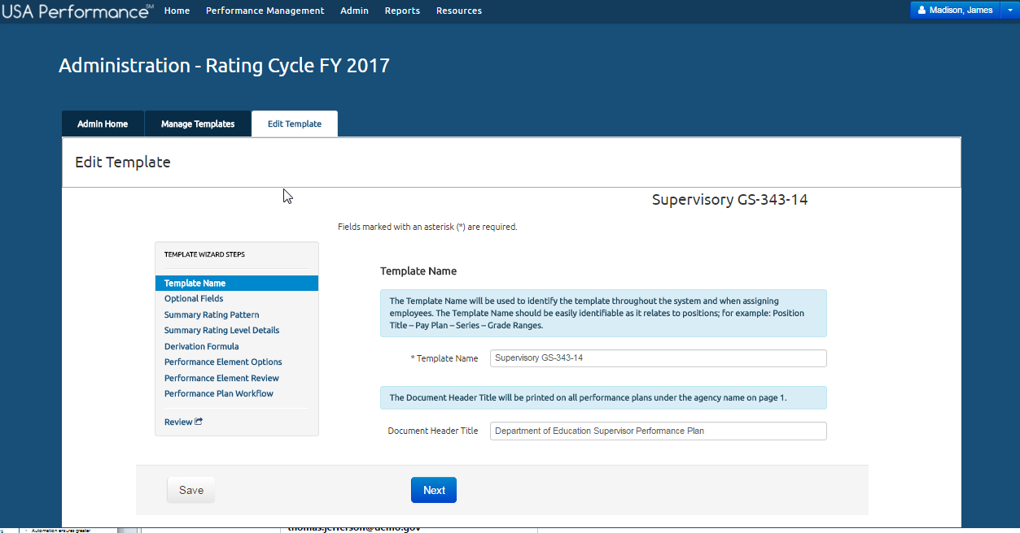
HR Professionals
Enables HR professionals to be less transactional and more transformational
Reduces time spent on transactional tasks through streamlined navigation
Includes full workflow management and tracking
Provides ability to check the status of all agency performance plans by division or employee at any time
Ensures standardization of the process throughout the agency
Complete customization by agency
USA Performance Customize Agency Plan Templates
Notes:
Human resources has transformed from a clerical occupation to a strategic function. USAP helps implement the performance management piece of the HR lifecycle.

Slide 7
System Access

Slide 8
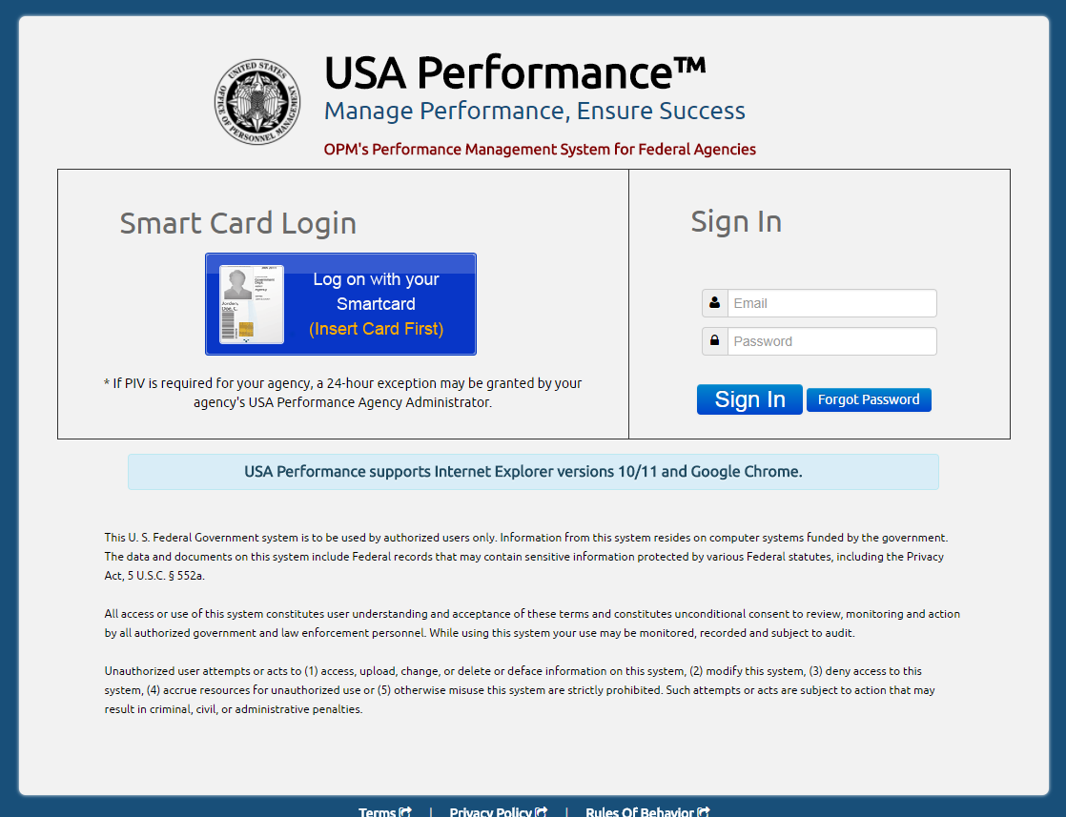
System Access
PIV Enforced
Requires PIV Registration
PIV Only
PIV Enabled
Sign in with Username/Password
Authorized Browsers
Chrome or IE 10 and higher
Notes:
Talk about exception – PIV Override, etc

Slide 9
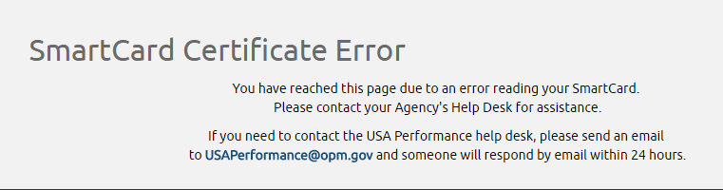
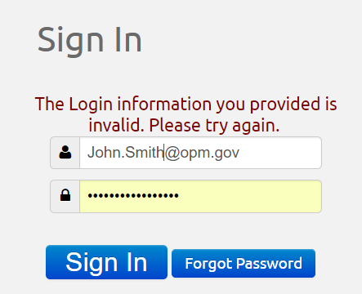


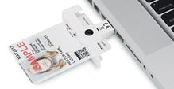
Common Access Problems
Smartcard
Certificate Errors
.08, .12, .13
Manual Login
Password
Notes:
Remind participants about certificates ending in .08, .12, .13.

Slide 10

Time to Test the System!
Log in to the Live Site
Turn to page 3 of your workbook

Slide 11
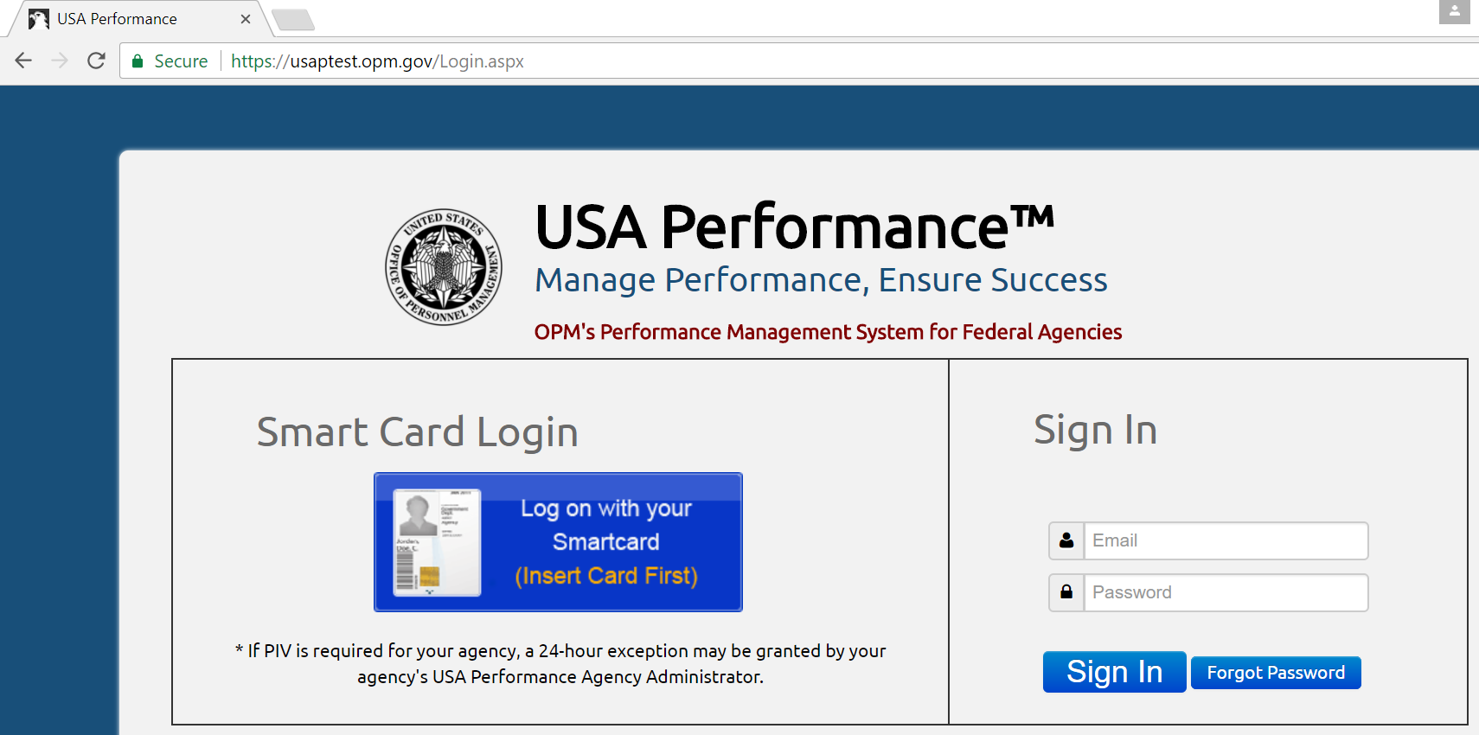
USA Performance Test Site
The Test Site
Training Resource for Admins
Test latest functionality
Allows Admins the opportunity to better understand the system from the perspective of each user role
https://usaptest.opm.gov/

Slide 12
Time to Test the System!
Log in to the Test Site
Turn to page 4 of your workbook

Slide 13
System Orientation

Slide 14
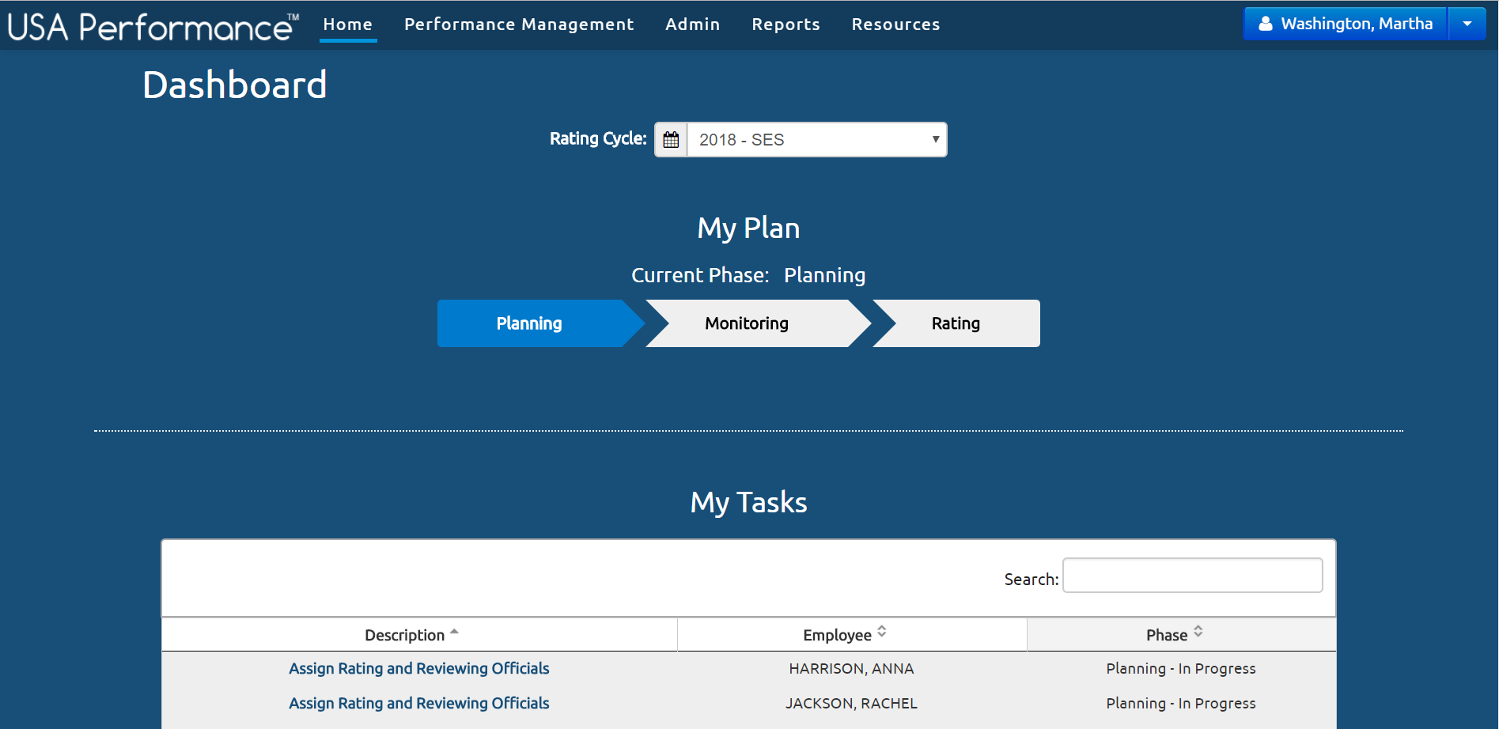
System Orientation
System Navigation Bar
Rating Cycle Dropdown
Select desired Rating Cycle (SES or Non SES)
User Profile Dropdown
Log off or initiate proxy settings
My Plan
The status of your performance plan in the selected Rating Cycle
My Tasks
Tasks for you to complete in the selected Rating Cycle

Slide 15
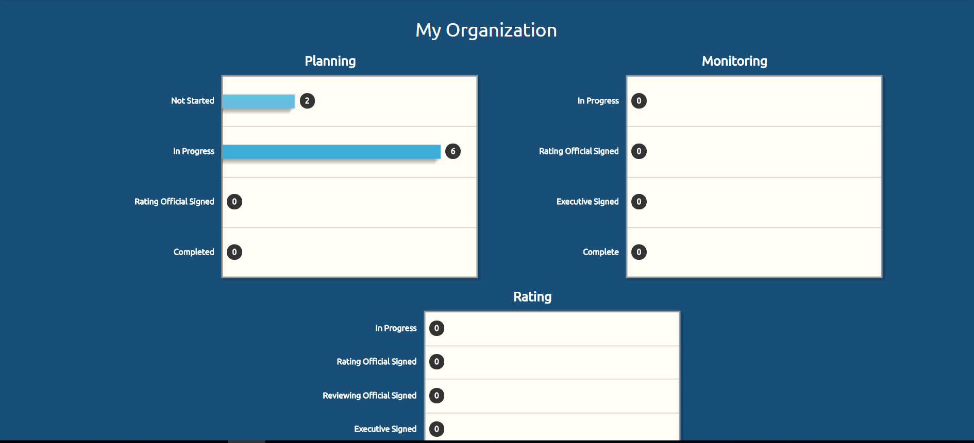
System Orientation
My Organization
Visual representation of all employees you have administrative rights for and their performance plan status

Slide 16
Demo the System

Slide 17
Time to Test the System!
Orient Yourself to the System
Turn to page 4 of your workbook

Slide 18
Performance Management Tab

Slide 19
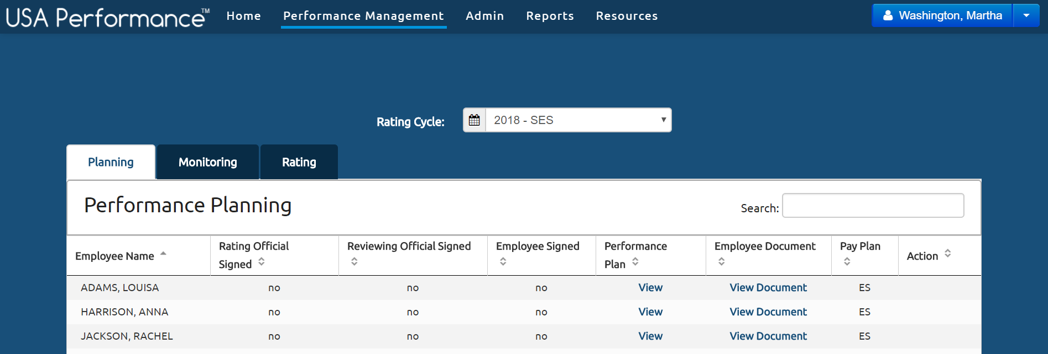
Performance Management Tab
Rating Cycle Drop Down
Select desired rating cycle (SES or Non SES)
Phases of Performance Management Cycle
Allows you to see employees in each phase
Sort and Filter
See progress of plans by phase

Slide 20
Demo the System

Slide 21
Time to Test the System!
Navigate the Performance Management Tab
Turn to page 5 of your workbook

Slide 22
Admin Tab

Slide 23
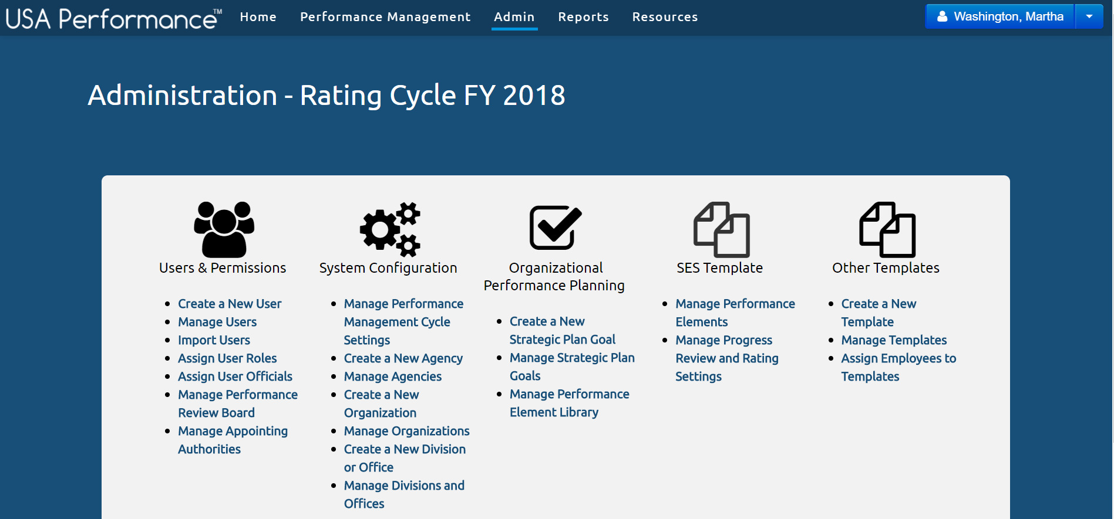
Admin Tab
Manage Users
Manage System Configuration
Manage Libraries (Strategic Goals and Performance Elements)
Manage Templates (SES and non-SES)

Slide 24
Demo the System

Slide 25
Time to Test the System!
Navigate the Admin Tab
Turn to page 5 of your workbook

Slide 26
Reports Tab

Slide 27
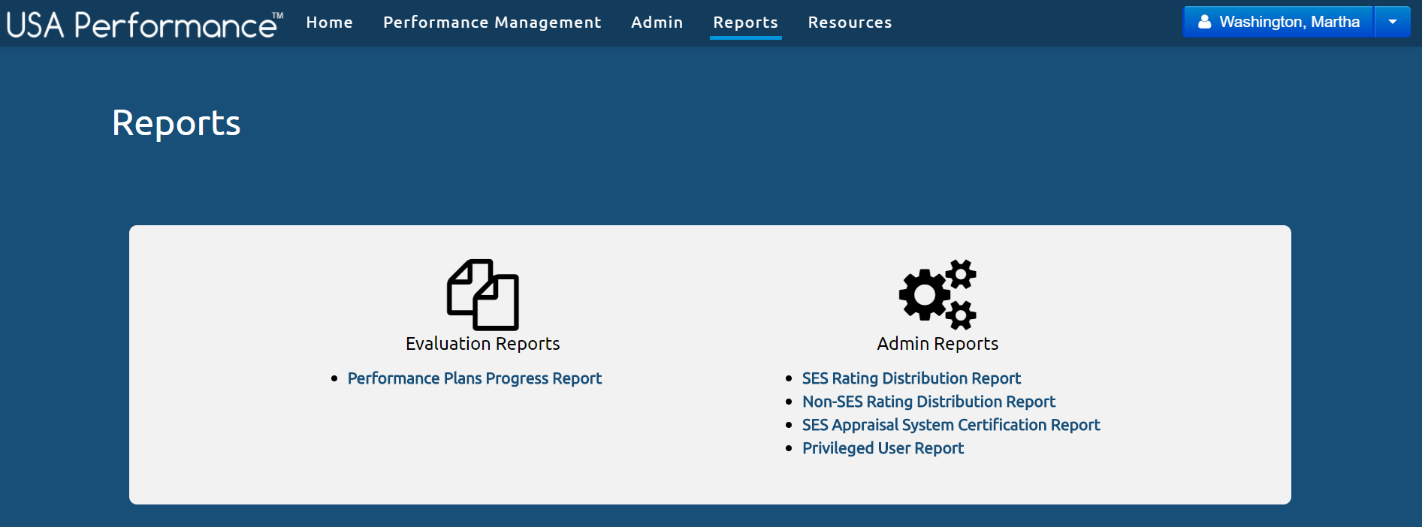
Reports Tab
Run Performance Plan Progress Report
Run Rating Distribution, System Certification, and Privileged User Reports

Slide 28
Demo the System

Slide 29
Time to Test the System!
Navigate the Reports Tab
Turn to page 6 of your workbook

Slide 30
Resources Tab

Slide 31
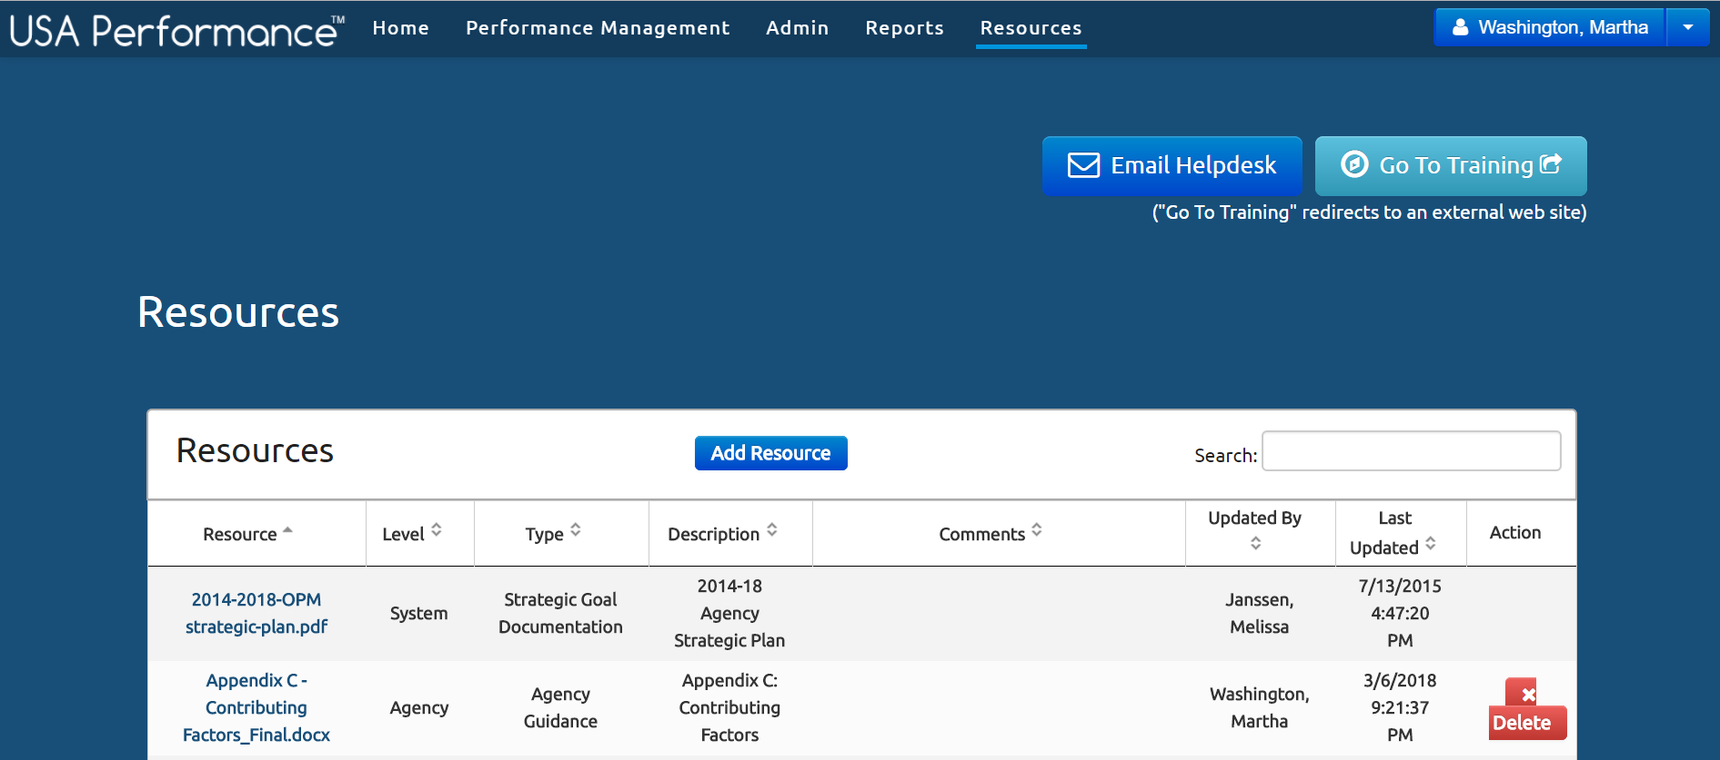
Resources Tab
Access Self-Paced Trainings
Contact Help Desk
Agency-Uploaded Resources

Slide 32
Demo the System

Slide 33
Time to Test the System!
Navigate the Resources Tab
Turn to page 6 of your workbook

Slide 34
Proxies

Slide 35
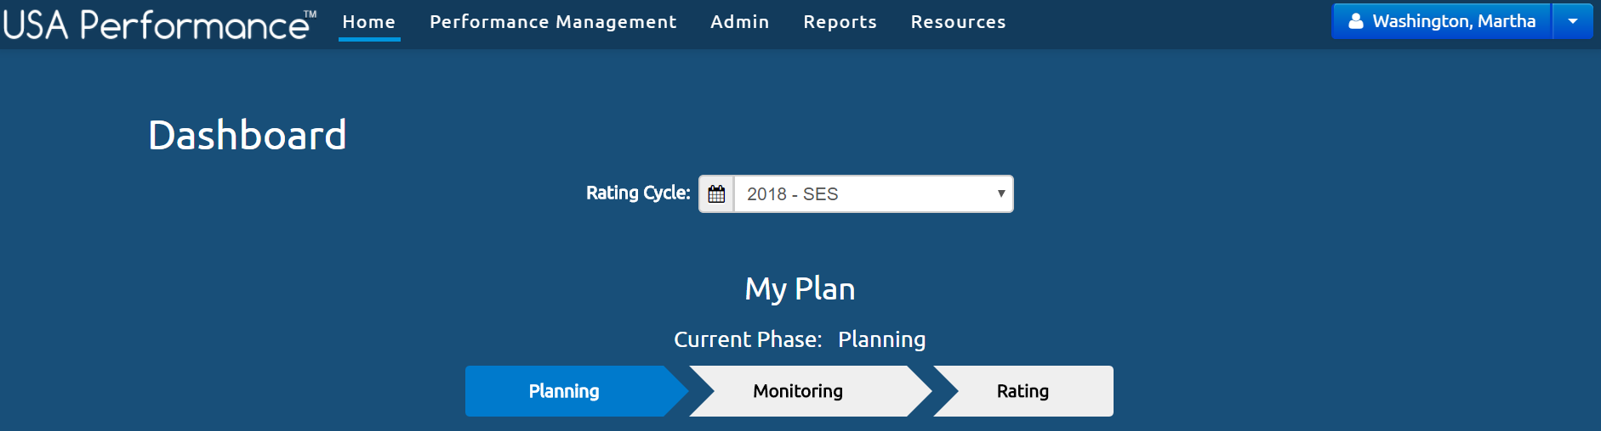
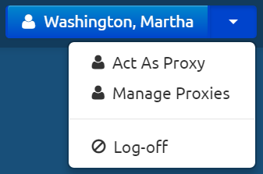
Proxies
Often proxies are added by supervisors to help with the performance management process.
What can a proxy do?
Edit Plans
Write Notes
Upload documents
What can’t a proxy do?
Sign performance plans
Remove signatures

Slide 36
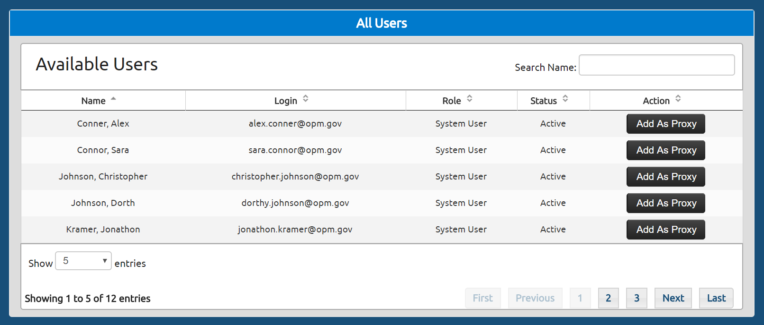
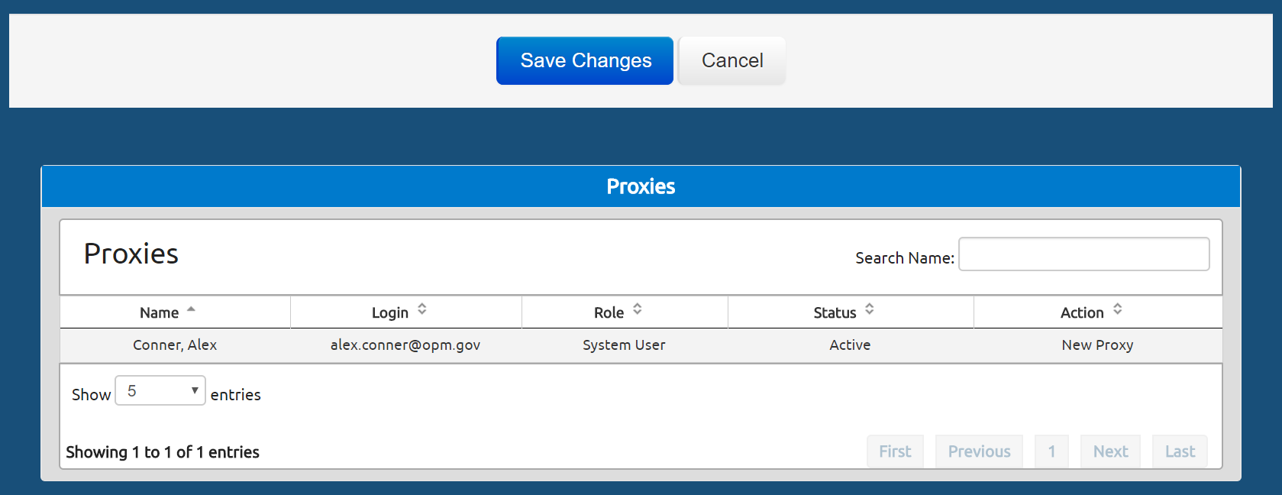
Add A Proxy
Steps
Select Manage Proxies
Select Add as Proxy next the appropriate user
Select Save Changes

Slide 37
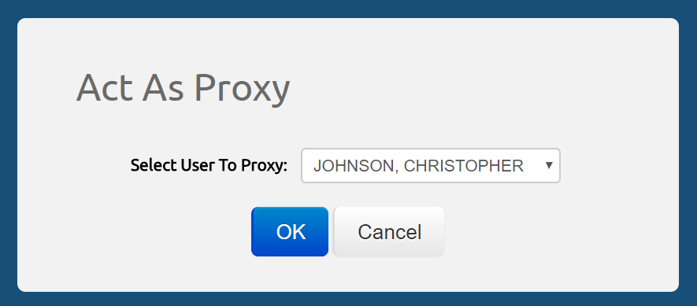
Act as a Proxy
Steps
Select Act as a Proxy
Select the user you’d like to proxy for
Select OK to save changes
Note: An Agency Administrator cannot add a proxy to work on behalf of another user in the system. Only the end user can add a proxy to work on their behalf.

Slide 38
Demo the System

Slide 39
Time to Test the System!
Add a Proxy User
Turn to page 6 of your workbook

Slide 40

Check on Learning!
Turn to page 7 of your workbook

Slide 41
For More Information, Contact:
[insert account manager name]
Account Manager, USA Performance
[insert email]
[insert phone number]

